Slide 1
Introduction to Machine Learning and Deep Leaning

Slide 2
Before Machine Learning

Slide 3
Models, models, models “experimental data”
We build models all the time. What are the models ?
Why models are important ?
What do models give us as scientists and engineers ?

Slide 4






Need to select the capacity of the circuit breaker.

Slide 5
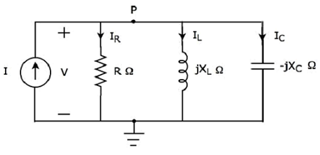
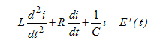
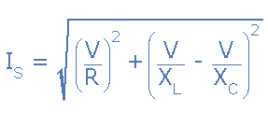
The classical approach
Step 2: Build the electric model.
Step 3: find The mathematical model and use it.

Slide 6
But Sometimes Modelling with fundamental laws is really hard.
Because:
Maybe we don’t have enough “Science”.
The phenomena under study is really complicated, and very stochastic in nature. “ consider economic, social, biological, and climate phenomena”.

Slide 7
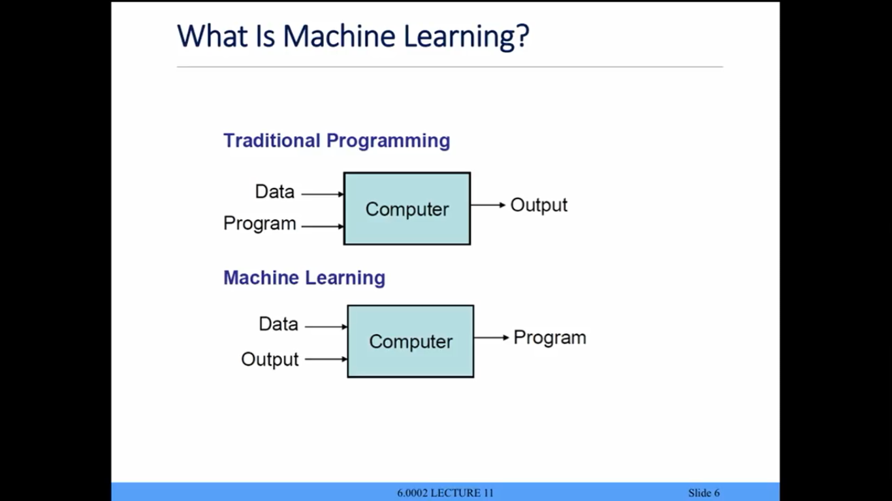
What is Machine Learning ?
Traditional programming vs Machine learning.

Slide 8
How would ML solve the previous problem ?

Slide 9
It’s all about experimentation
Collect your data by experiments :
- plug devices and measure the current.
* Find the relationship between the no. of plugged devices and the current.

Slide 10
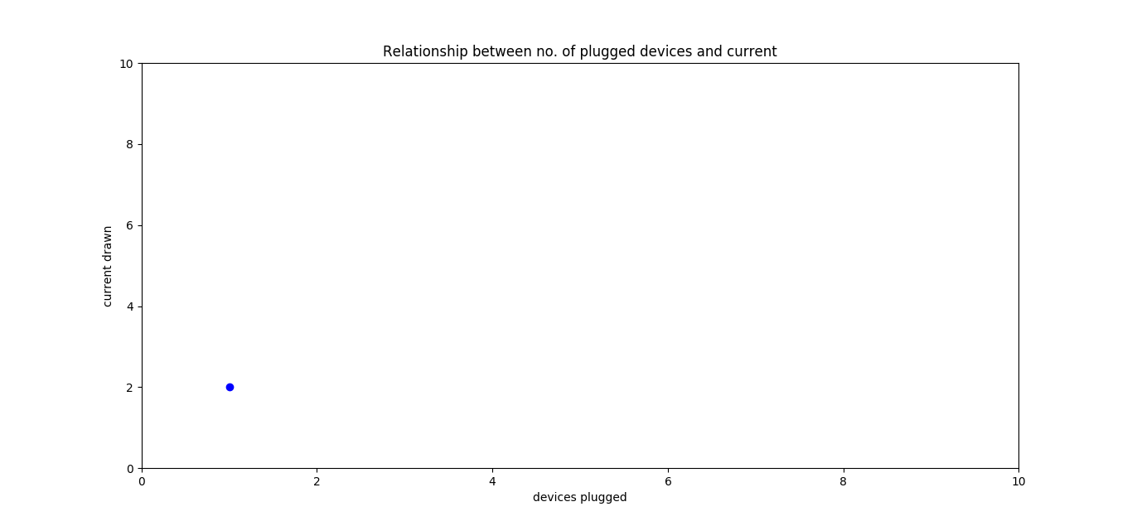

Slide 11
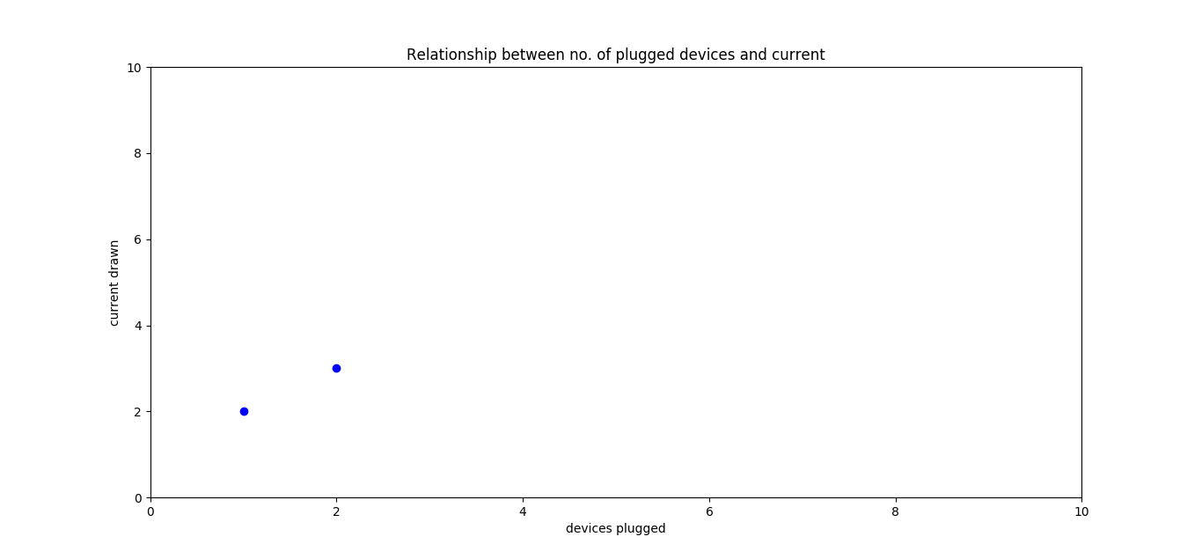

Slide 12
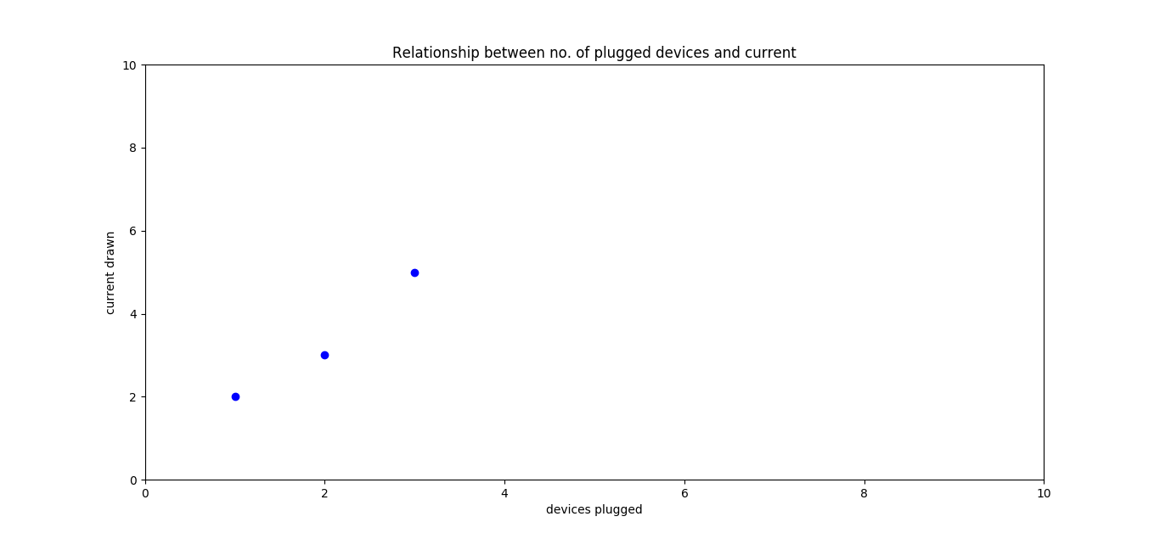

Slide 13
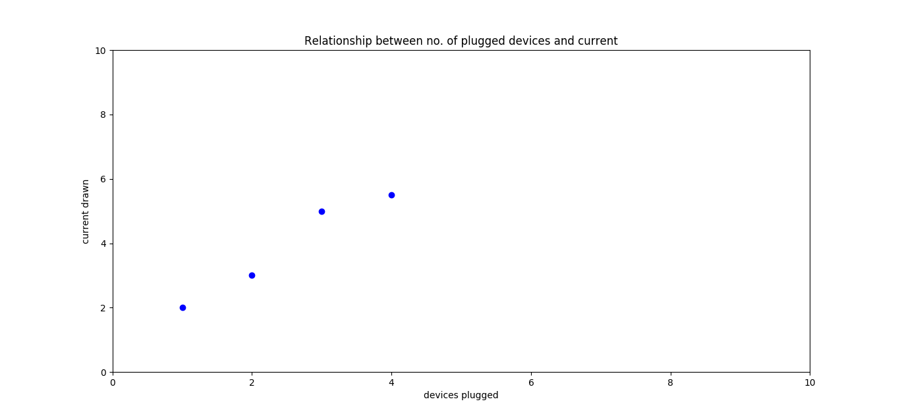

Slide 14
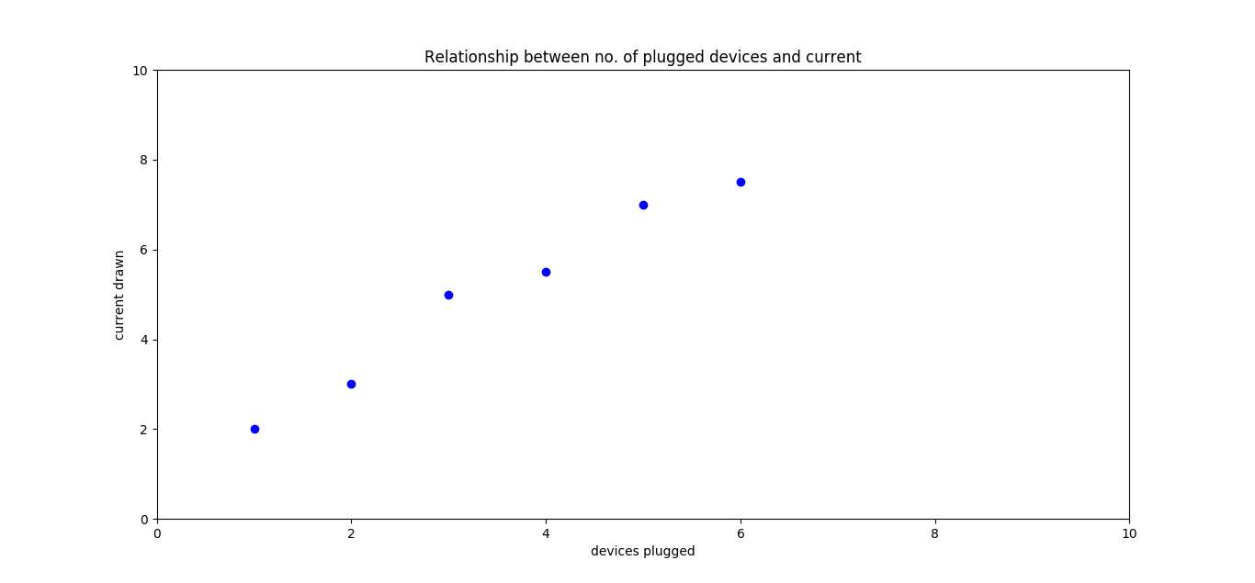

Slide 15
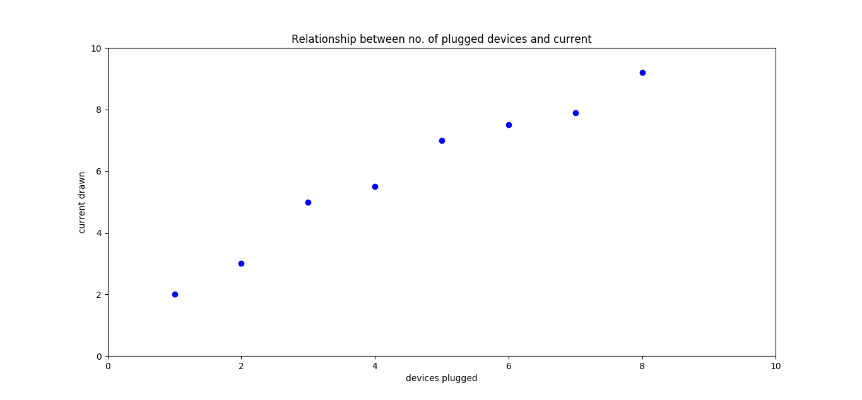

Slide 16
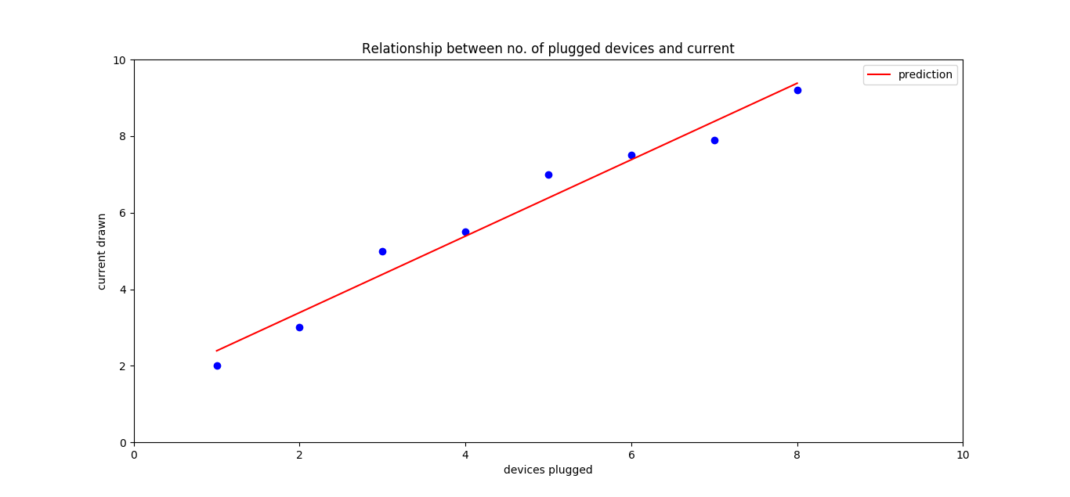

Slide 17
The most essential component for successful machine learning is the data.

Slide 18
The main steps of Machine Learning
Objective definition.
Learn Mapping from x -> y directly.
Model selection.
Feature extraction.
Optimization.
Using the model.

Slide 19
Optimization
Features
Model
Output
Loss

Slide 20
The Concept of Parametrized Model
parameter
parameter
parameter
Model

Slide 21
Steps:
You need to have X and the True Y:
Start with initial model (random parameters).
Feed X into the model , and Compute predicted Y.
Compare predicted Y to True Y.
From the result of the comparison “modify” the model such that the next time you feed X into the model, the result will be more similar to True Y.

Slide 22
Optimization
x
Model
Y
Compare
Y to Y

Slide 23
What are the features? Why are they important ?
Back to modelling ? How do we get features ?

Slide 24
Introduction to Deep Learning
In a nutshell:
Instead of taking “ready to use” features. Let’s learn how to extract the features (i.e. learnable feature extraction).
In practice this is done with Deep Neural networks (more layers + some clever tricks !!).

Slide 25
Deep Learning
Optimization
Features
Model
Output
Loss

Slide 26
Let’s do some machine Learning ourselves: Finding if the animal is reptile or not
Features (X) : Information about the animal
Output (label, Y) : Reptile or not.
Model : simple (if condition model).

Slide 27
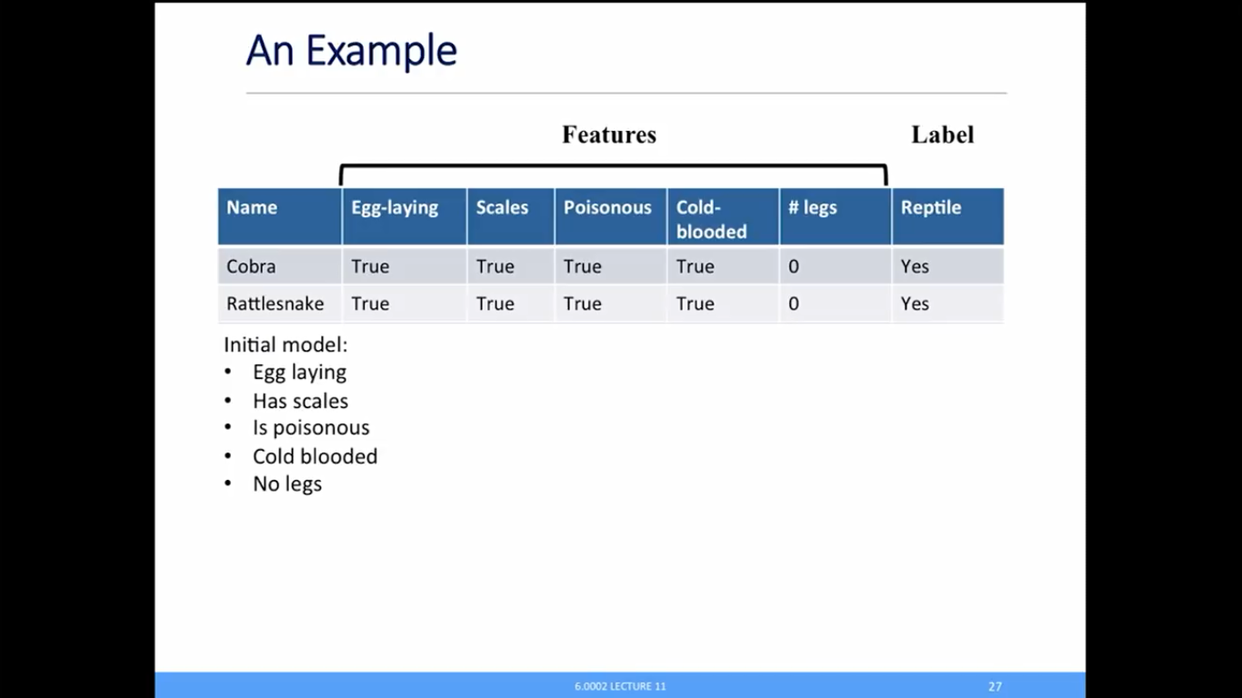

Slide 28
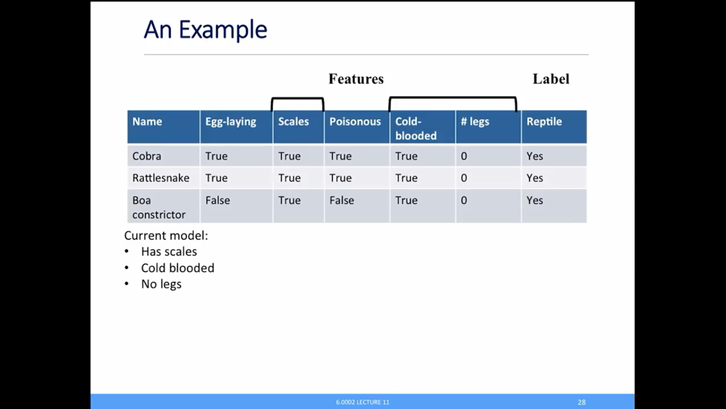
Added new example
Modify Old model

Slide 29
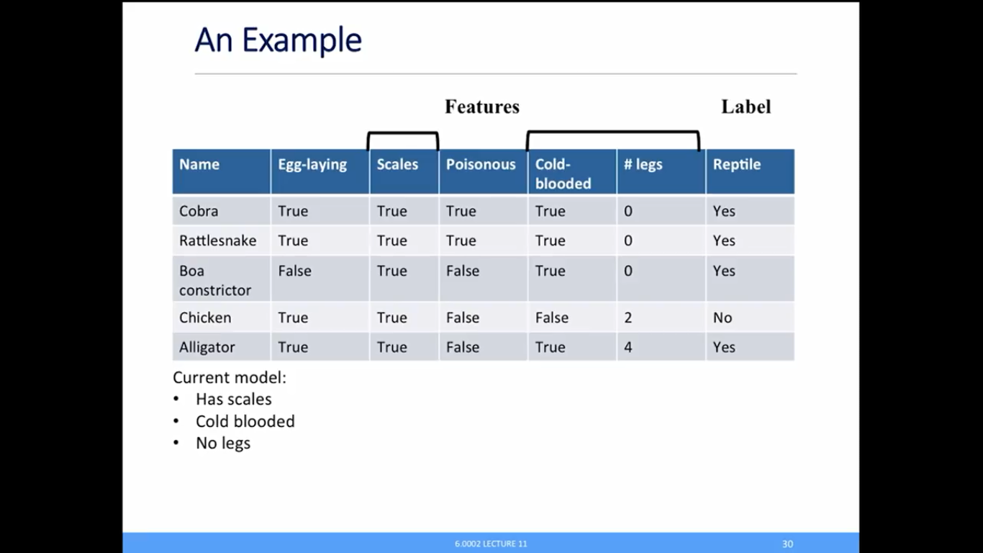
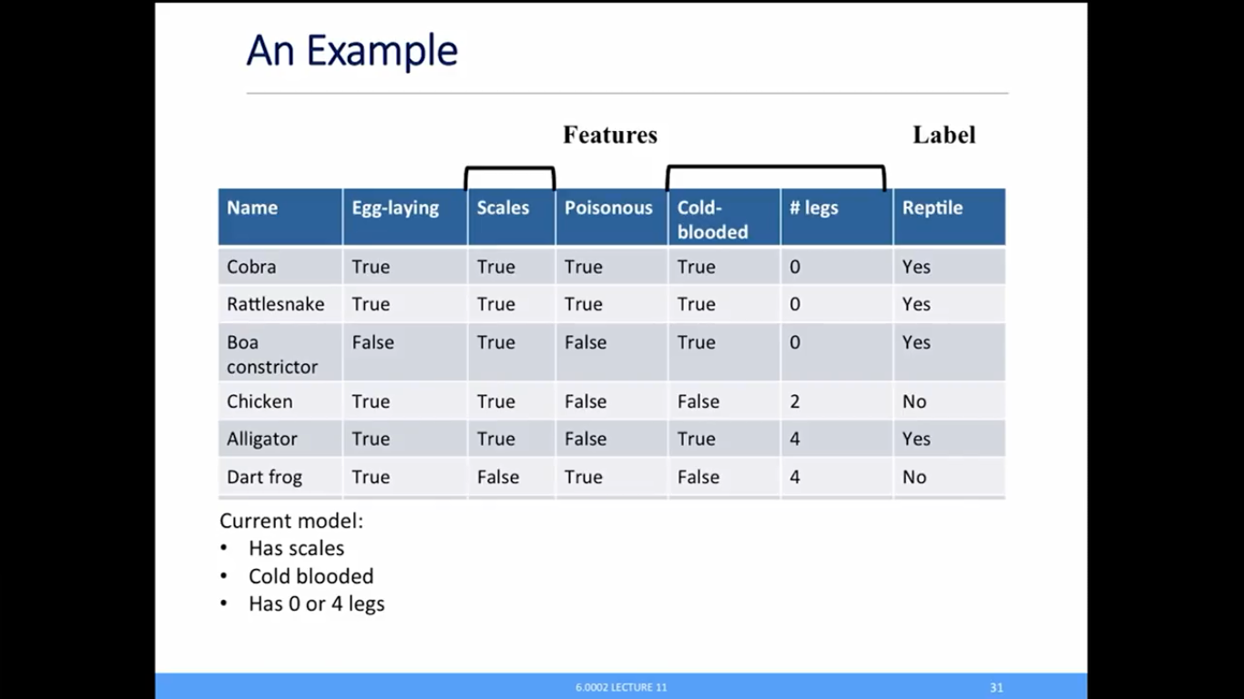
Modify Old model

Slide 30
And continue until your model doesn’t change …. This process of updating the model is called the training and in the current machine learning it is done by continuous optimization (finding minima problem … P.S. “do you remember you 1st year calculus XD).

Slide 31

Machine Learning learns based on correlation. Correlation ≠ Causation Pigeon superstition

Slide 32
The most Important take away
All models are WRONG but some are USEFUL.
Garbage in Garbage out !

Slide 33
References
We adopted some of the graphs from : MIT 6.0002 course: introduction Eric Grimson, John Guttag, and Ana Bell. 6.0002 Introduction to Computational Thinking and Data Science. Fall 2016. Massachusetts Institute of Technology: MIT OpenCourseWare, https://ocw.mit.edu. License: Creative Commons BY-NC-SA.
Pigeon Superstition, from Mr. No body intro : YouTube, YouTube, www.youtube.com/watch?v=mpi0qsp3v_w.

